Slide 1
MolaJob
Managing Product Development
Product Manager: Duplex YOUNKAP
© 2019 Udacity. All rights reserved.

Slide 2



Starter PRD and Prototype
We start with the updated PRD from the previous project
We start with the prototype from the previous project
Starter PRD
Prototype

Slide 3


MolaJob Team
These are the people on our team
Product Manager
Engineering Lead
QA
Designer
Data Analytics
Product Design
Legal Compliance
Product Marketing
Customer Service
Finance Accounting

Slide 4
Test Plan
Create a test plan to validate everything is built to spec and working correctly
© 2019 Udacity. All rights reserved.
Notes:
[ALL PARTICIPATION]

Slide 5
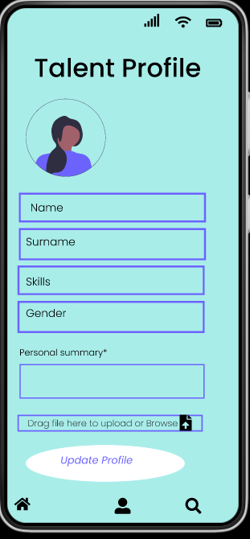
Test Cases #1: Functional Requirements
Feature 1#Talent Profile | Steps | Expected Behavior | Priority
 | Step 1 : Users login using (email/pwd) Step 2 : Users enter his personal data (Profile Picture,Job Focus,Countries I want to work in, Preferred Employment Types ,Preferred Ways of Working , Preferred Start Date , Languages I can work in, Country of Residence , City based in , LinkedIn URL , Send me jobs via email, My CV , Personal summary) in the required fields Step 3 : Users click on “update profile” button | FC1 : user information are saved (commit in the database) FC2 : user profile with updated information appears in the dashboard | P0

Slide 6
Test Cases #1: Non-functional Requirements
Requirement | Steps to reproduce | Priority
NFC1 : The updated information will appear in the user dashboard within 30s | Same as above | P3

Slide 7
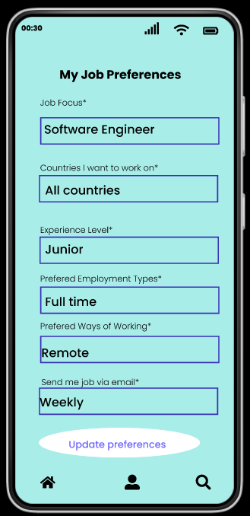
Test Cases #2: Functional Requirements
Feature 2#Job Preferences | Steps | Expected Behavior | Priority
 | Step 1 : land on the page by clicking “profile icon” in the “button middle” of the screen Step 2 : Enter user job preference (Job Focus,Countries I want to work in, Preferred Employment Types, Languages I can work in) in the required fields Step 3 : Users click on “update preferences” button | FC3 : job preferences are saved (commit in the database) FC4 : user Talent Profile dashboard is updated | P3

Slide 8
Test Cases #2: Non-functional Requirements
Requirement | Steps to reproduce | Priority
NFC2 The Job preference information will update those enter by user when creating a profile | Same as above | P0

Slide 9
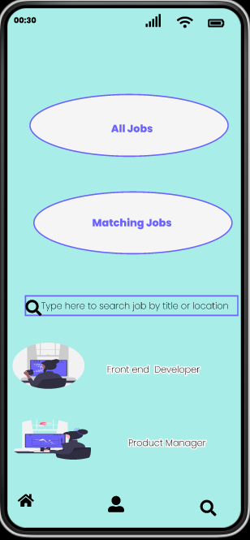
Test Cases #3: Functional Requirements
Feature 3#Search Job | Steps | Expected Behavior | Priority
 | Step 1 : land on the page by clicking “search” in the “button right” of the screen Step 2 : Enter key elements (role, salary, skills, type) for the position you're looking for in the “rectangular text area” in the “middle of your screen” Step 3 : Users click on “search button” in the “button right” of the screen | FC4 : Job matching the criteria you enter will appear in the same screen | P0

Slide 10
Test Cases #3: Non-functional Requirements
Requirement | Steps to reproduce | Priority
NFC3 LImit the job posting to 5 most relevant | Same as above | P4

Slide 11
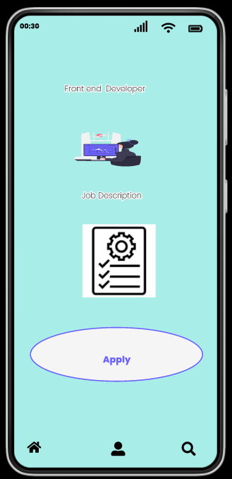
Test Cases #4: Functional Requirements
Feature 4#Apply Job | Steps | Expected Behavior | Priority
 | Step 1 : Click on the “icon of job role” from the preview screen Step 2 : Review job description to confirm it match your interest Step 3 : Apply for a job by click in “Apply” | FC5 : After a user apply for a job, confirmation email is send | P0

Slide 12
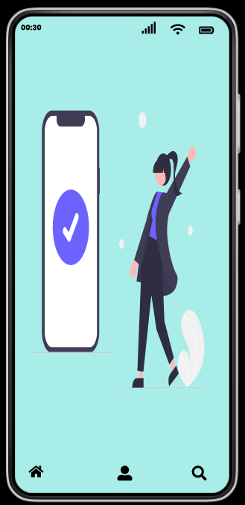
Test Cases #4: Non-functional Requirements
Requirement | Steps to reproduce | Priority
NFC1 : The confirmation email is send within 5 min the job application has been submit | Same as above | P2

Slide 13
Dogfood Survey
Create a dogfood survey to get insight from real world usage
© 2019 Udacity. All rights reserved.
Notes:
[ALL PARTICIPATION]

Slide 14

Dogfood Survey
Link your survey

Slide 15
Prioritize
Issues come up. Keep the team focused on the things that matter the most
Notes:
[ALL PARTICIPATION]

Slide 16
Fire Drills
Scenario | Who | Communication Method | Key Messages
QA finished testing and reported that 3 test cases failed | Engineering Team & QA | Meeting | The purpose of this meeting is to discuss about the 3 failed test Prioritize/build actions plan to solve those issues
An engineer is ready to start working on the next feature, but doesn’t have the mocks for it | Product Design | Ping | Any update about the latest version of the mock Kindly share with Engineering Team as soon as possible
Support flagged that many users are unable to sign in to their accounts | Engineering Team & QA | Ping | Support report a critical sign in issue from many user This is a critical situation that affect the usage of our app Let me know about actions taken to resume normal operation
Dogfood survey results are in and dogfooders are not excited about recommending the product | Engineering Team & QA | Doc | The dogfoog survey result show that dogfooders are not excited about the app Kindly take a closer look and share your feeling in the doc
Legal informed you about a new law going into effect that will require you to add new privacy controls before you can launch | Data Analytic & Engineering Team & QA | Meeting | There is a new law affecting our launch We need to add new privacy controls
A new PM just joined your team and is interested in learning about your work | Product Manager | Doc | Here the latest version the documents of our current scrum Feel free to share you thoughts in the document (comments, concern, appreciation)

Slide 17
Prioritize
Scenario | Priority Ranked | Rationale
QA finished testing and reported that 3 test cases failed | 2 | Failed test cases could result in bad users experience if not resolve in time This can cause reputation and financial loss to our company
An engineer is ready to start working on the next feature, but doesn’t have the mocks for it | 5 | The unavailability of a mock is blocker for engineer It could cause delay in the project resulting in poor team performance It could also affect engineer’s motivation
Support flagged that many users are unable to sign in to their accounts | 1 | Users unable to sign in can directly affect our business revenue and reputation This is a critical issue which has to be handle as soon as possible
Dogfood survey results are in and dogfooders are not excited about recommending the product | 4 | Dodfood feedback is an important test of our app in the real condition The team needs to address the dogfooder concern in a due time This could be blocker for the launch
Legal informed you about a new law going into effect that will require you to add new privacy controls before you can launch | 3 | Legal compliance in data privacy a normally a blocker for the launch It could result in fraud, financial and reputation loss Team need to address this issue in a due time before launch
A new PM just joined your team and is interested in learning about your work | 6 | It is important to share with new PM necessary information to catch up with the team It could help to avoid burdening the team with communication

Slide 18
Go No Go
Run a go / no go meeting to decide if the product is ready to launch, and communicate out any risks and mitigations in place
Notes:
[ALL PARTICIPATION]

Slide 19
MolaJob
Enable recent graduates search and apply for a job based on their skills and preferences.
Facilitate the discovery of Africa Gold Talent by the biggest company in the World.
Provide support to graduate to growth in skills , build a portfolio through real world projects.
Provide documents template and reviews to boost your application.
Provide a trusted platform where graduates fellow can connect or chat with mentors and recruiters connect.
Key Features:
Talent Profile : user create profile , enter their personal data
Job Preferences : user enter their preferences for job they want
Job Search : enable user to query job by entering key elements
Job Application : enable user to apply for a job
Job Board : enable user to see job description and related information

Slide 20
Talent Profile
Ready to Launch
Some Risk
At Risk
completed
Testing:
All test cases passed
Dogfood:
Positive feedback from dogfooders
Open Issues / Risk:
Synchronization with data added by user to set “Job preferences”
Mitigations:
Prioritizes data from the “Job Preferences” features for job recommendation
Production Readiness:
Users data successfully commit in the database when creation or update
Numbers of new users per weeks
Rating score

Slide 21
Job Application
Ready to Launch
Some Risk
At Risk
In Review
Testing:
Application email confirmation delay (10 min after submission)
Open Issues / Risk:
Job application documents not review on time by mentor
Mitigations:
Users can still go ahead and submit his application is mentor don’t provide feedback within 2 hours.
Dogfood:
Dogfooder reports not receiving email confirmation after applying for a Job
Production Readiness:
Number of job application per weeks
Ratio number of email not receive/number of job application
Rating score

Slide 22
Search Job
Ready to Launch
Some Risk
At Risk
In Review
Testing:
All test cases passed
Open Issues / Risk:
Job recommendation are sometimes not relevant for not STEM related Job
Mitigations:
AI/ML model is continue train on new data to avoid drift
Support can train users to enter relevant information for search a job
Dogfood:
Job not match users skills and preferences
Production Readiness:
User rating
Accuracy of AI/ML model

Slide 23
Recommendation: Launch
The app help user to perform the core component of our solution (create profile, set job preferences, search job by entering key element, Apply for a Job)
User not receiving confirmation email on time can affect user experience, reputation, the costumer support and marketing team can inform user about the issue. The issue should also be documented in the user training guide
Job application not matching the preferences is due to the accuracy or drift in the model. Engineering should continue monitor model performance in production

Slide 24
Invitation: Go / No Go Launch Meeting
To:
Engineering Lead
QA
Designer
Data Analytics
Product Marketing
Customer Service
Finance Accounting
Legal Compliance
Dear Collaborator
I am excited to inform you that our MolaJob App is ready to launch.
We ready to provide to recent graduates in Africa a frustration free Job search experience. The app at the current state is stable and ready for launch
Of course there still having few issue like AI/ML accuracy, email confirmation but the mitigation measures are set to handle those issue.
This is a major milestone of our project.
As Product Manager, I would like to express my gratitude to team members for their hardship and dedication.
We could not reach this step without your commitment and dedication.
Thanks

Slide 25
Responding to Feedback
Your director:
This all looks really promising! Can we launch two weeks earlier than originally planned?
Your response:
Dear Director
Thank for your appreciation, the team has been working so hard.
On behalf of the team, I would like to thank you for your commit and providing resources for the project.
Product launch a critical task , need preparation to make sure that double check and fix issue.
Launching early will be great , but it could also bring risk to the project.
With you permission, I propose to maintain the initial date for launch

